Slide 1

Games Preservation Masterclass

Slide 2


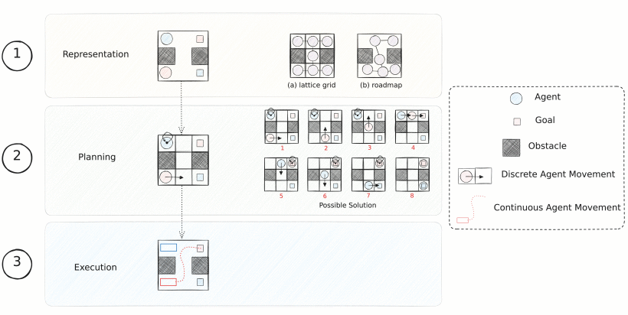
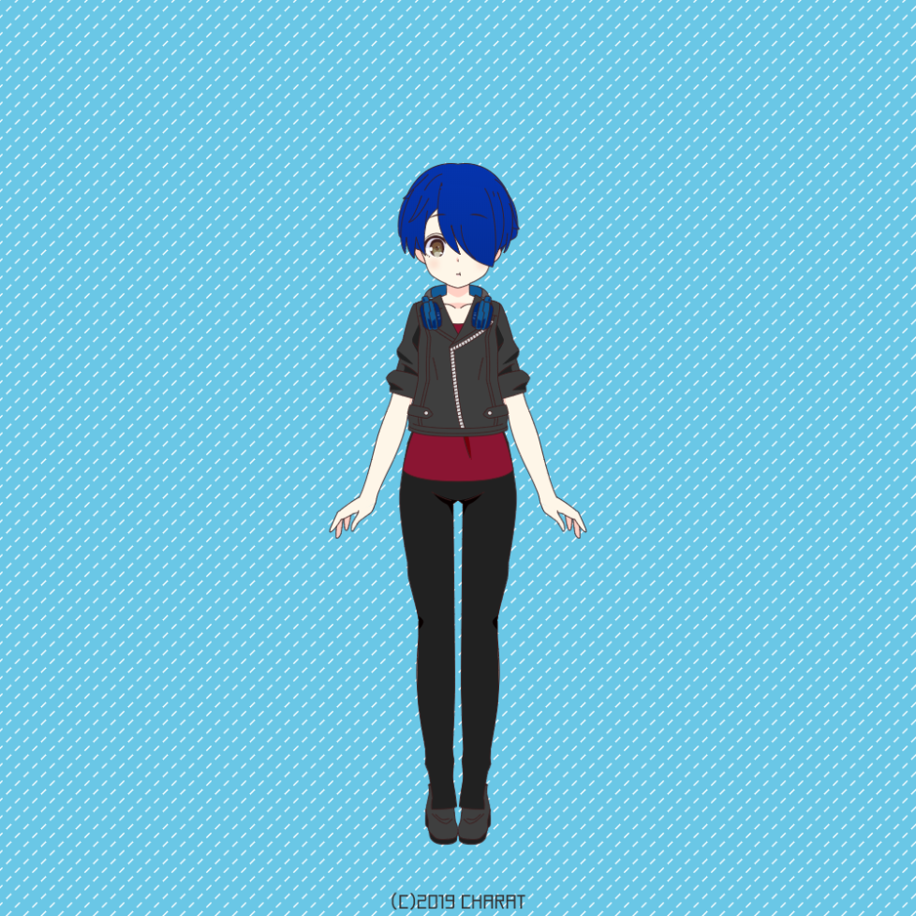


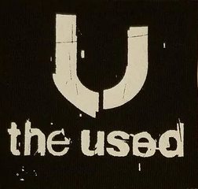









Workshop Facilitator
Rachel “Rach” Coster
Masters Student at the Tokyo Institute of Technology
rachel.coster@uts.edu.au
I do stuff sometimes, including:
Multi-agent Pathfinding
Travelling to Japan
Going to Punk Concerts
Sleeping
Translating Japanese Video Games

Slide 3
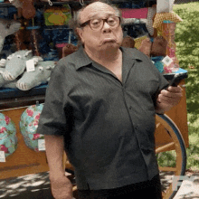
What are We Doing?
A few things!~
Workshop Overview & Setup
Key Software
Software to Hardware Pipeline
Introduction to Game Preservation
Decay of Physical Storage Mediums
Community Efforts in Preservation
Australian Law regarding Preservation

Slide 4
FAQ
I didn’t bring a laptop to this event
All good!~ Just Waddle Dee to the library in building two and rent a laptop using your student ID
I don’t have any Pokémon ROMS…
Someone in the room should have some but PLEASE DO NOT download them via UTS WIFI as it’s a legal grey area. I'd rather not get in trouble with UTS IT this close to graduation xD
I made a cool thing but it’s not running…
Please back up your ROMs prior to editing them. Things can go wrong and due to the somewhat fickle nature of Read Only Memory, it’s almost impossible to recover them back to a working state

Slide 5
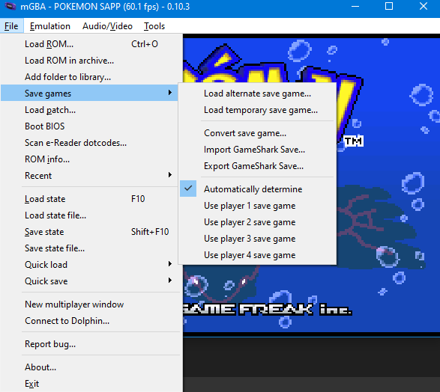
Emulator - MGBA
A lightweight Game Boy Advance emulator that supports the simulation of peripherals and is compatible with the majority of the console’s library of games
After editing a Pokémon ROM, load it and select the corresponding pre-made save state to see your changes

Slide 6
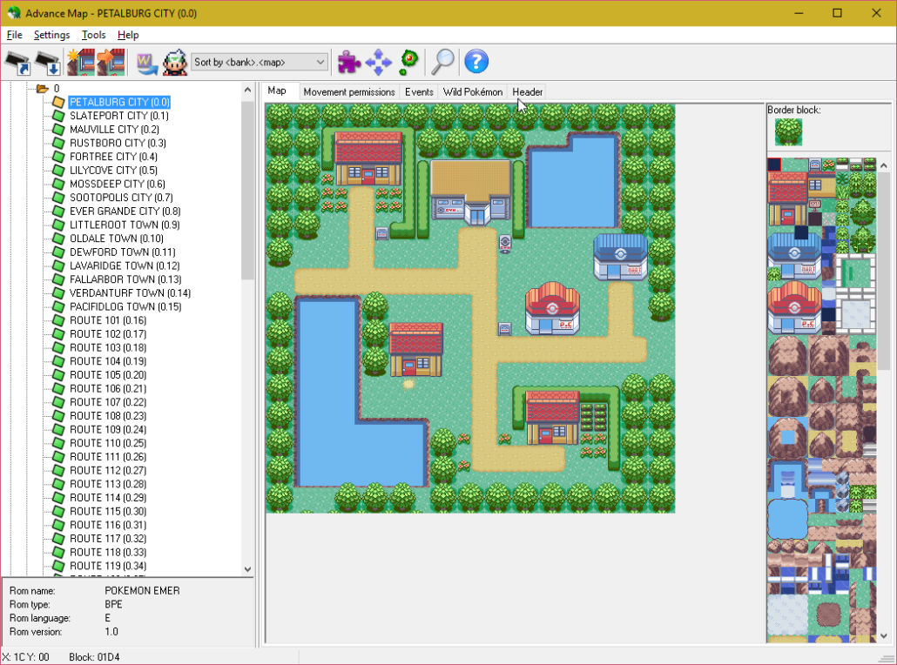
Map Editor – Advanced Map
A comprehensive map editing suite that allows for granular control over the following features such as:
Modify, delete, or add sprites within any map segment
Integrate custom sprites and link them to predefined behaviours
Define specific Pokémon encounters for each map segment

Slide 7
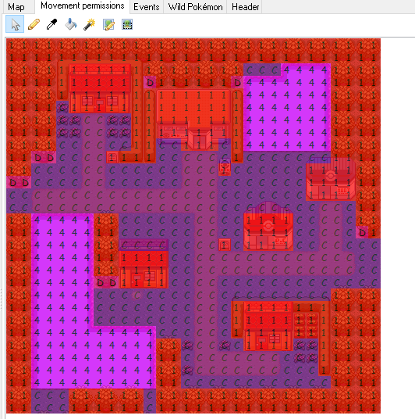
Advanced Map – Movement Positions
1 – Areas that do not allow player movement
4 – Water
C – Allows player movement

Slide 8
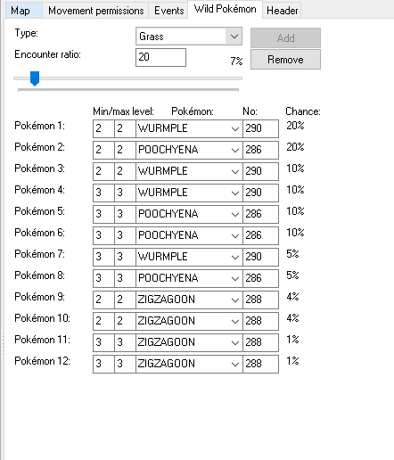
Advanced Map – Pokémon Encounters
Based on the type of behaviour allocated to a specific sprite, you can initiate a battle with a wild Pokémon
Each area can contain up to 12 different wild Pokémon species
Whilst the probability of encountering each Pokémon cannot be adjusted, encounter event itself can be modified

Slide 9
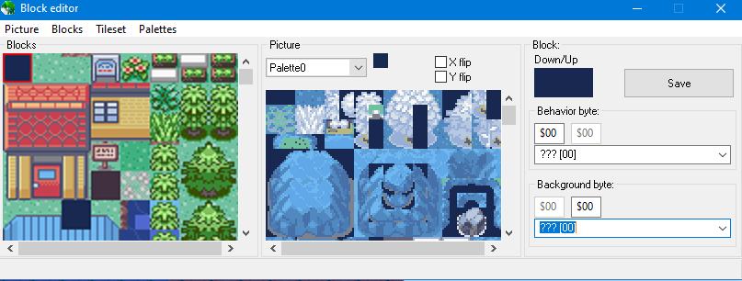
Advanced Map – Block Editor
Edit the behaviour of pre-existing or imported tiles

Slide 10
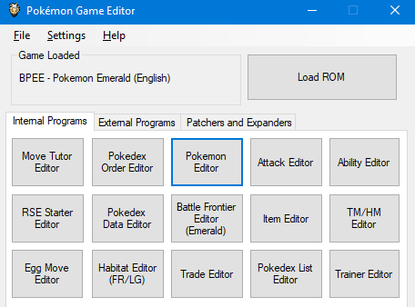
Pokémon Editor – Pokémon Game Editor
A comprehensive set of tools designed specifically for easy modification of all elements within Pokémon Game Boy Advance games.
This workshop will primarily focus on the Pokémon Editor and the Attack Editor

Slide 11
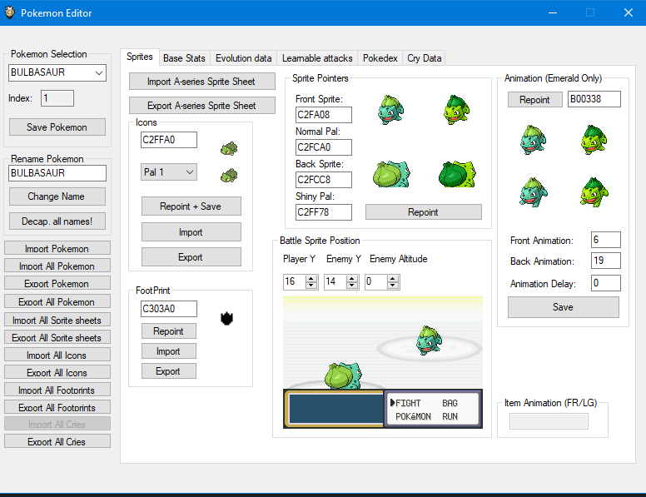
Pokémon Game Editor – Pokémon Editor

Slide 12
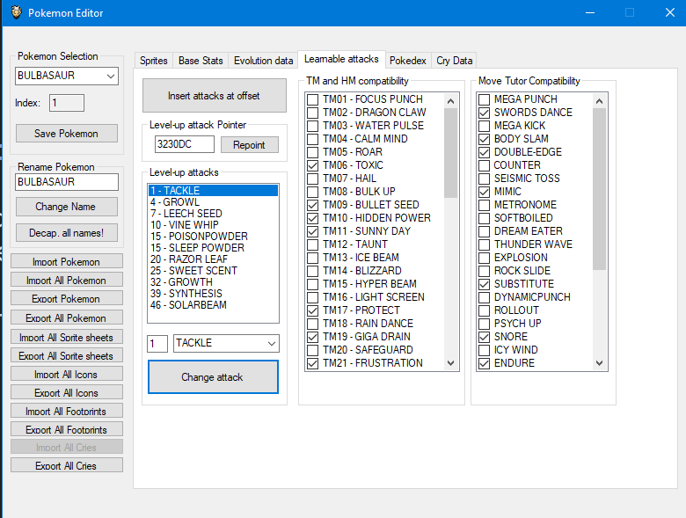
Pokémon Game Editor – Learnable Attacks
Select attacks and the levels in which they are learnt for a specific Pokémon
Attacks can be chosen regardless of their compatibility with the Pokémon's type

Slide 13
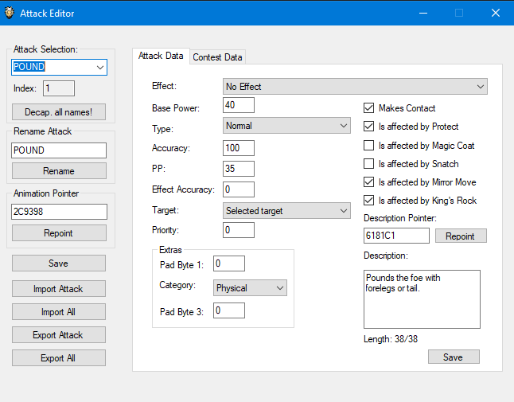
Pokémon Game Editor – Attack Editor
Edit pre-existing attacks and create new attacks both for battle and beauty contests
Pointers – Indicate a specific spot within the ROM via hexadecimal

Slide 14
Software to Hardware Pipeline
Copy the ROM & Save files onto a MicroSD card
Insert EZ Flash into Game Body Advance
Select Your ROM from the EZ-Flash Menu

Slide 15
Introduction to Video Games Preservation

Slide 16
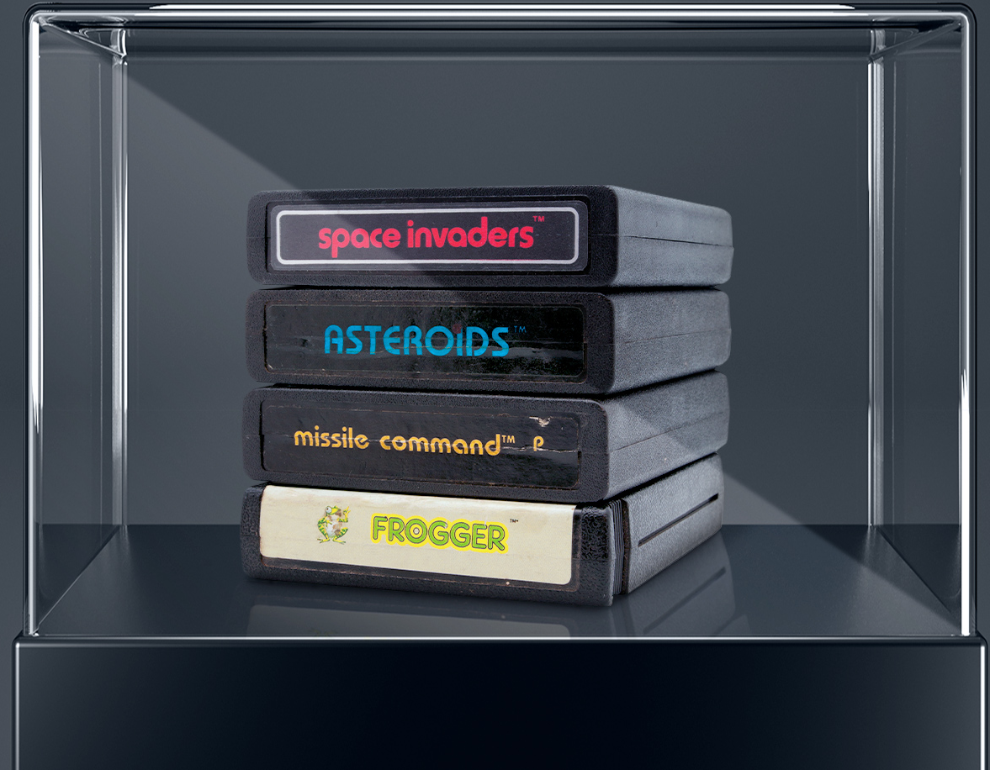
Video Game Preservation
A type of media preservation focused on the collation, retainment and compatibility of Video Games sourced from both physical media and the wider internet
Preservation is achieved via the successful archival of games on digital archives for the purpose of allowing them to be played irrespective of its original hardware and software dependencies

Slide 17
Decay of Physical Mediums
As physical mediums such as cartridges and discs start to decay, it is vital that video games, irrespective of their popularity are extracted and saved online.
Causes of Data Degradation are dependent on the physical medium:
Optical Media – i.e. CD-R, DVD-R etc.
Magnetic Media – i.e. Floppy Discs and Magnetic Tapes
Cartridges

Slide 18

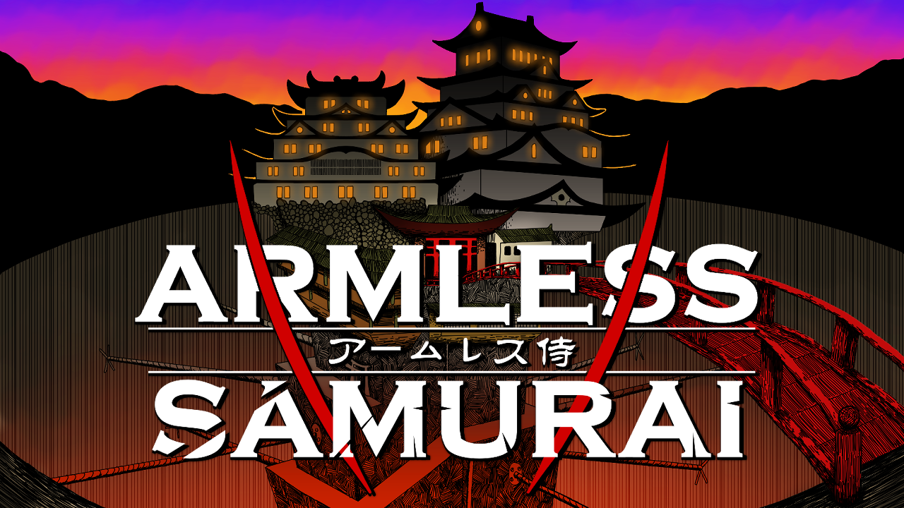
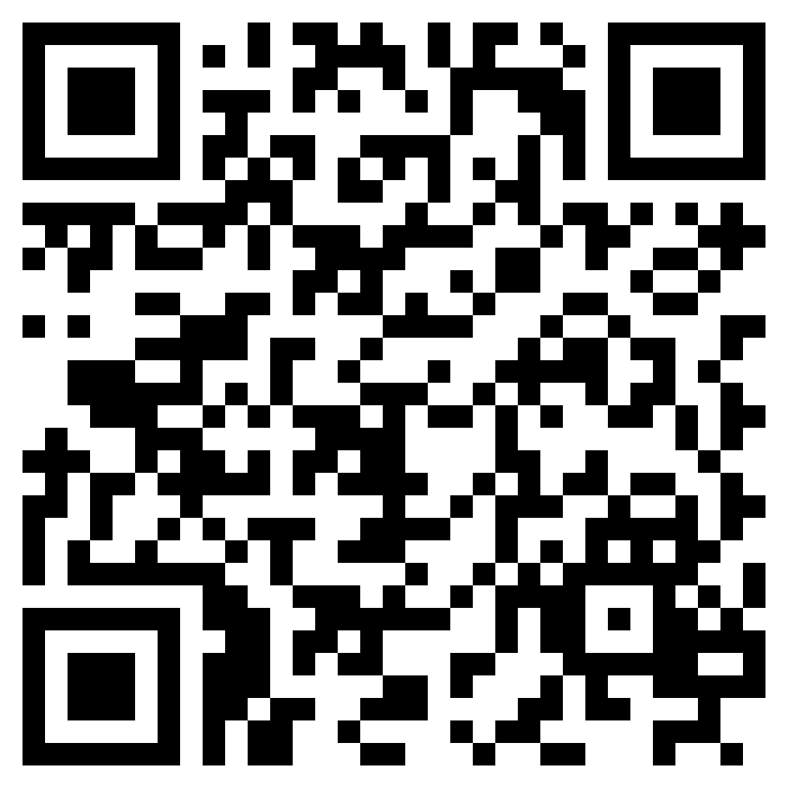
Shameless Plugs
UTS Playmakers Society
Thanks so much for helping advertise today’s workshop and for the lights!~
Their game, Armless Samurai is free to download from Steam
QR Code to the Game’s Steam Page

Slide 19


Shameless Plugs
UTS Programmer’s Society
Sure, here is a thank you message for Programmers Society:
This society has been with me for my entire university career at UTS and has always made me feel welcomed and appreciated. It’s been a joy to see so many students join and stay with this society until graduation. It has certainly changed a lot during the six years I have been a member, but it has all been for the better. This current cohort of students representing the society is the best yet, due to their ability to exude a natural curiosity towards learning whilst also being extremely inclusive. Thank you so much for letting me stick around ^.^
QR Code for ProgSoc’s Discord

Slide 20


Post-Workshop Survey
Keep your eyes peeled for a survey link in your inbox - it will arrive within 15 minutes of the event ending.
Your feedback is important so that we can make future TechFest events even better!!~

